Slide 1
Disrupting Racism in Family Engagement and Social Emotional Learning

Slide 2
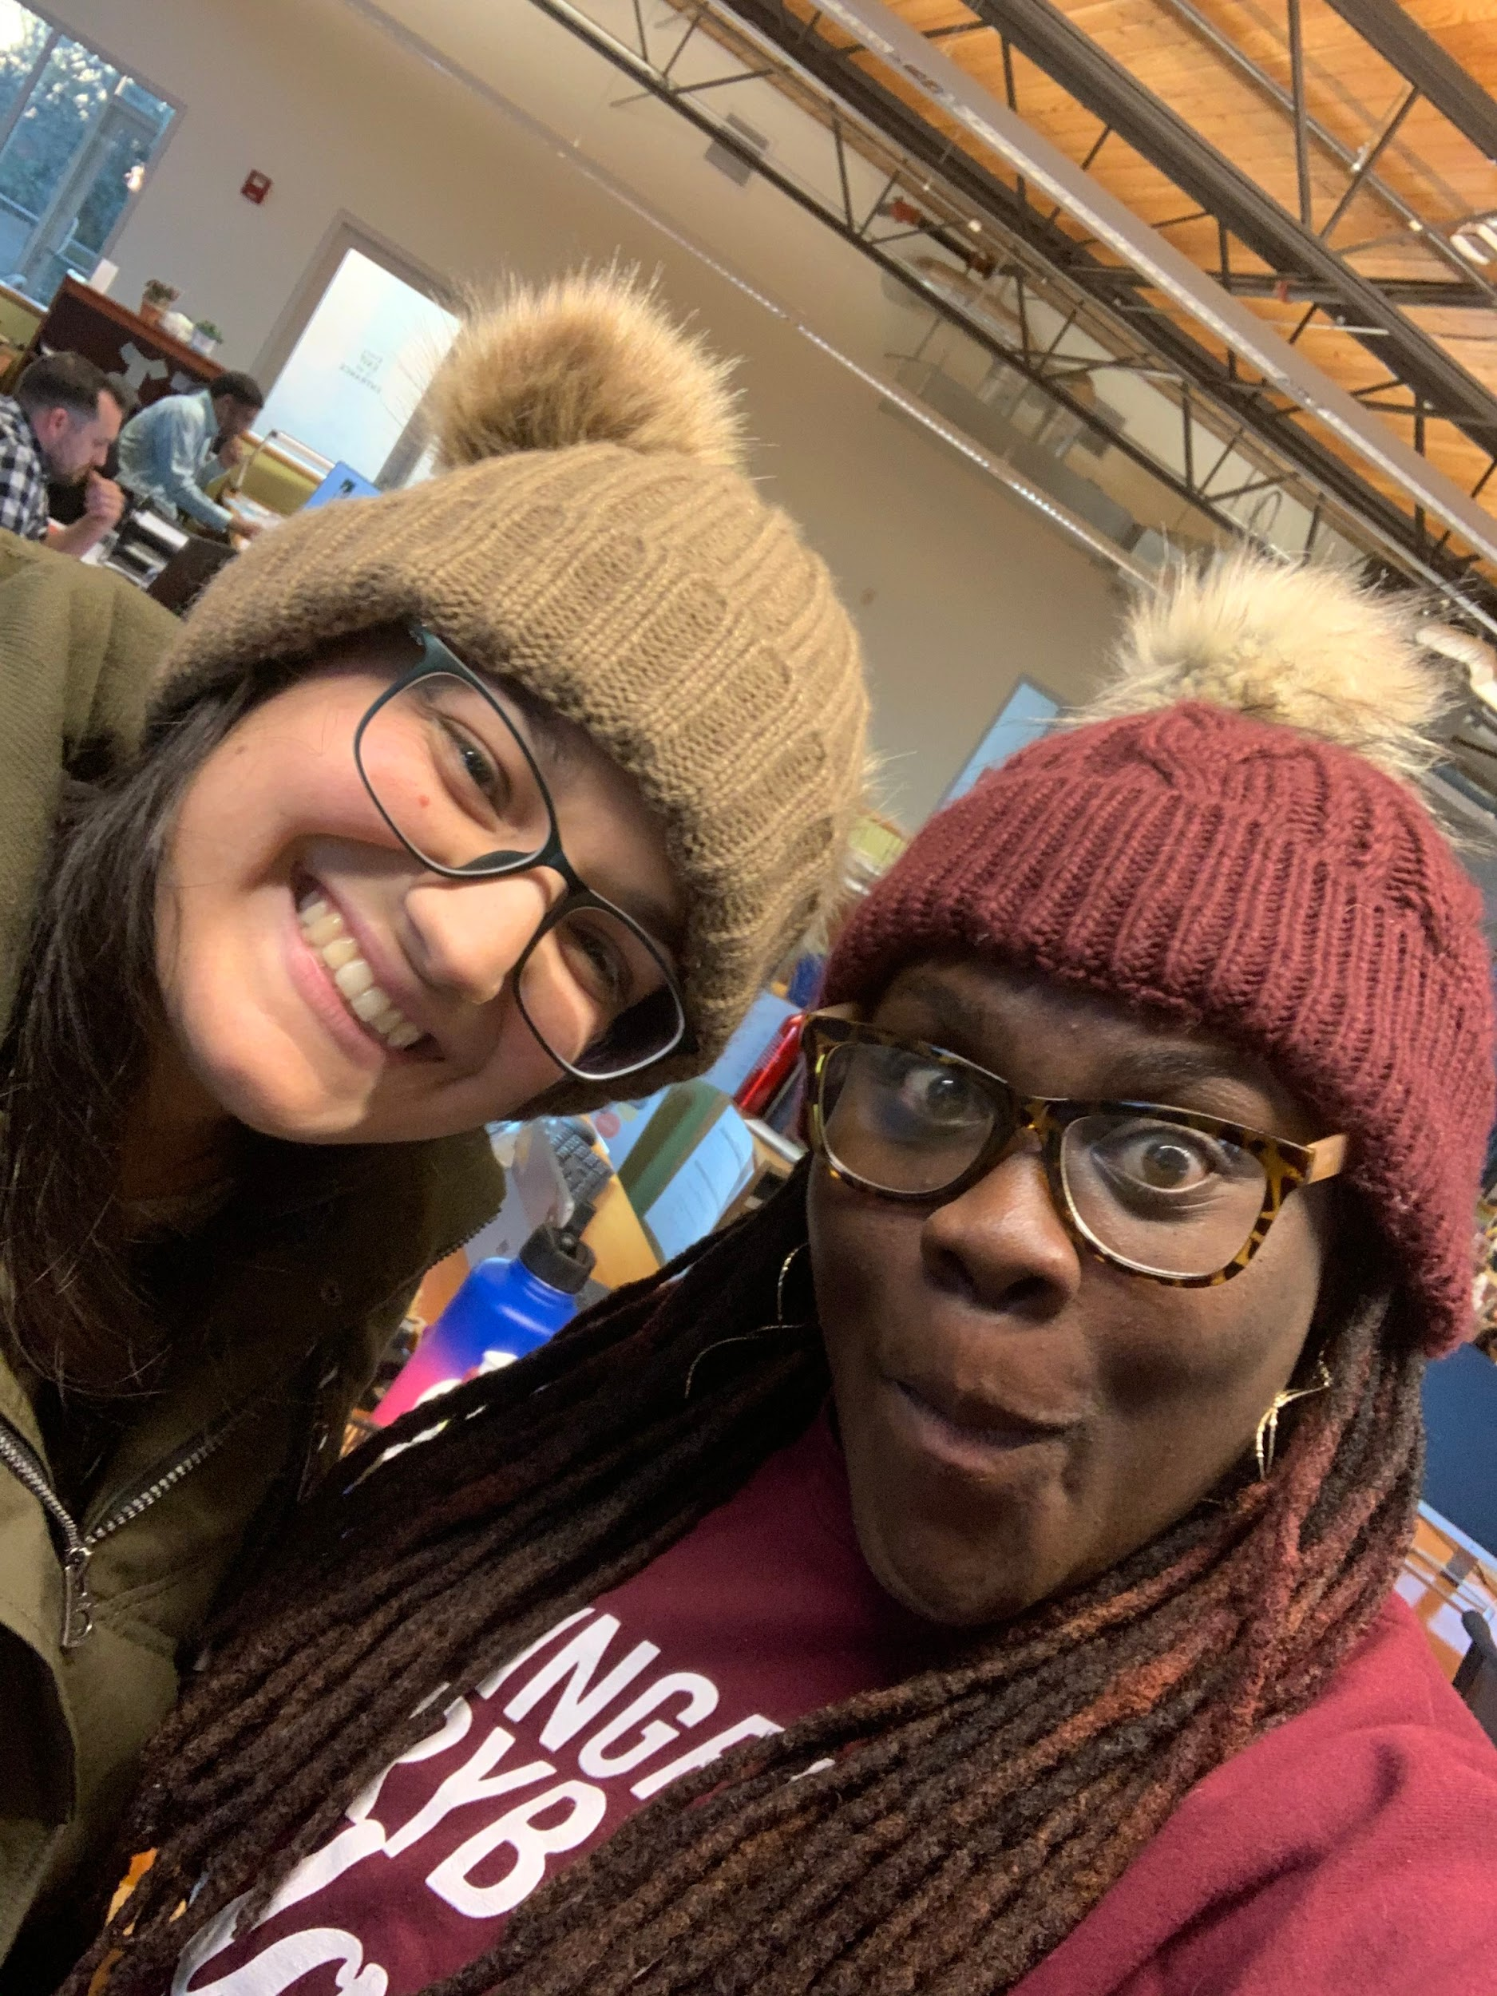
The Network for EdWork
Raedell Boateng, Ph.D
Director-Network for EdWork
Saara Kamal, MA TESOL
Program Manager-Martinez Fellowship

Slide 3
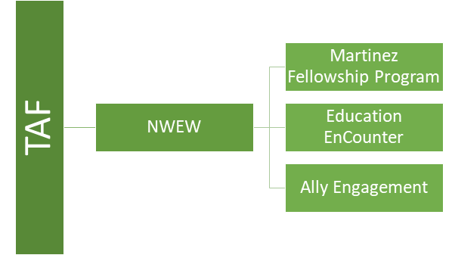
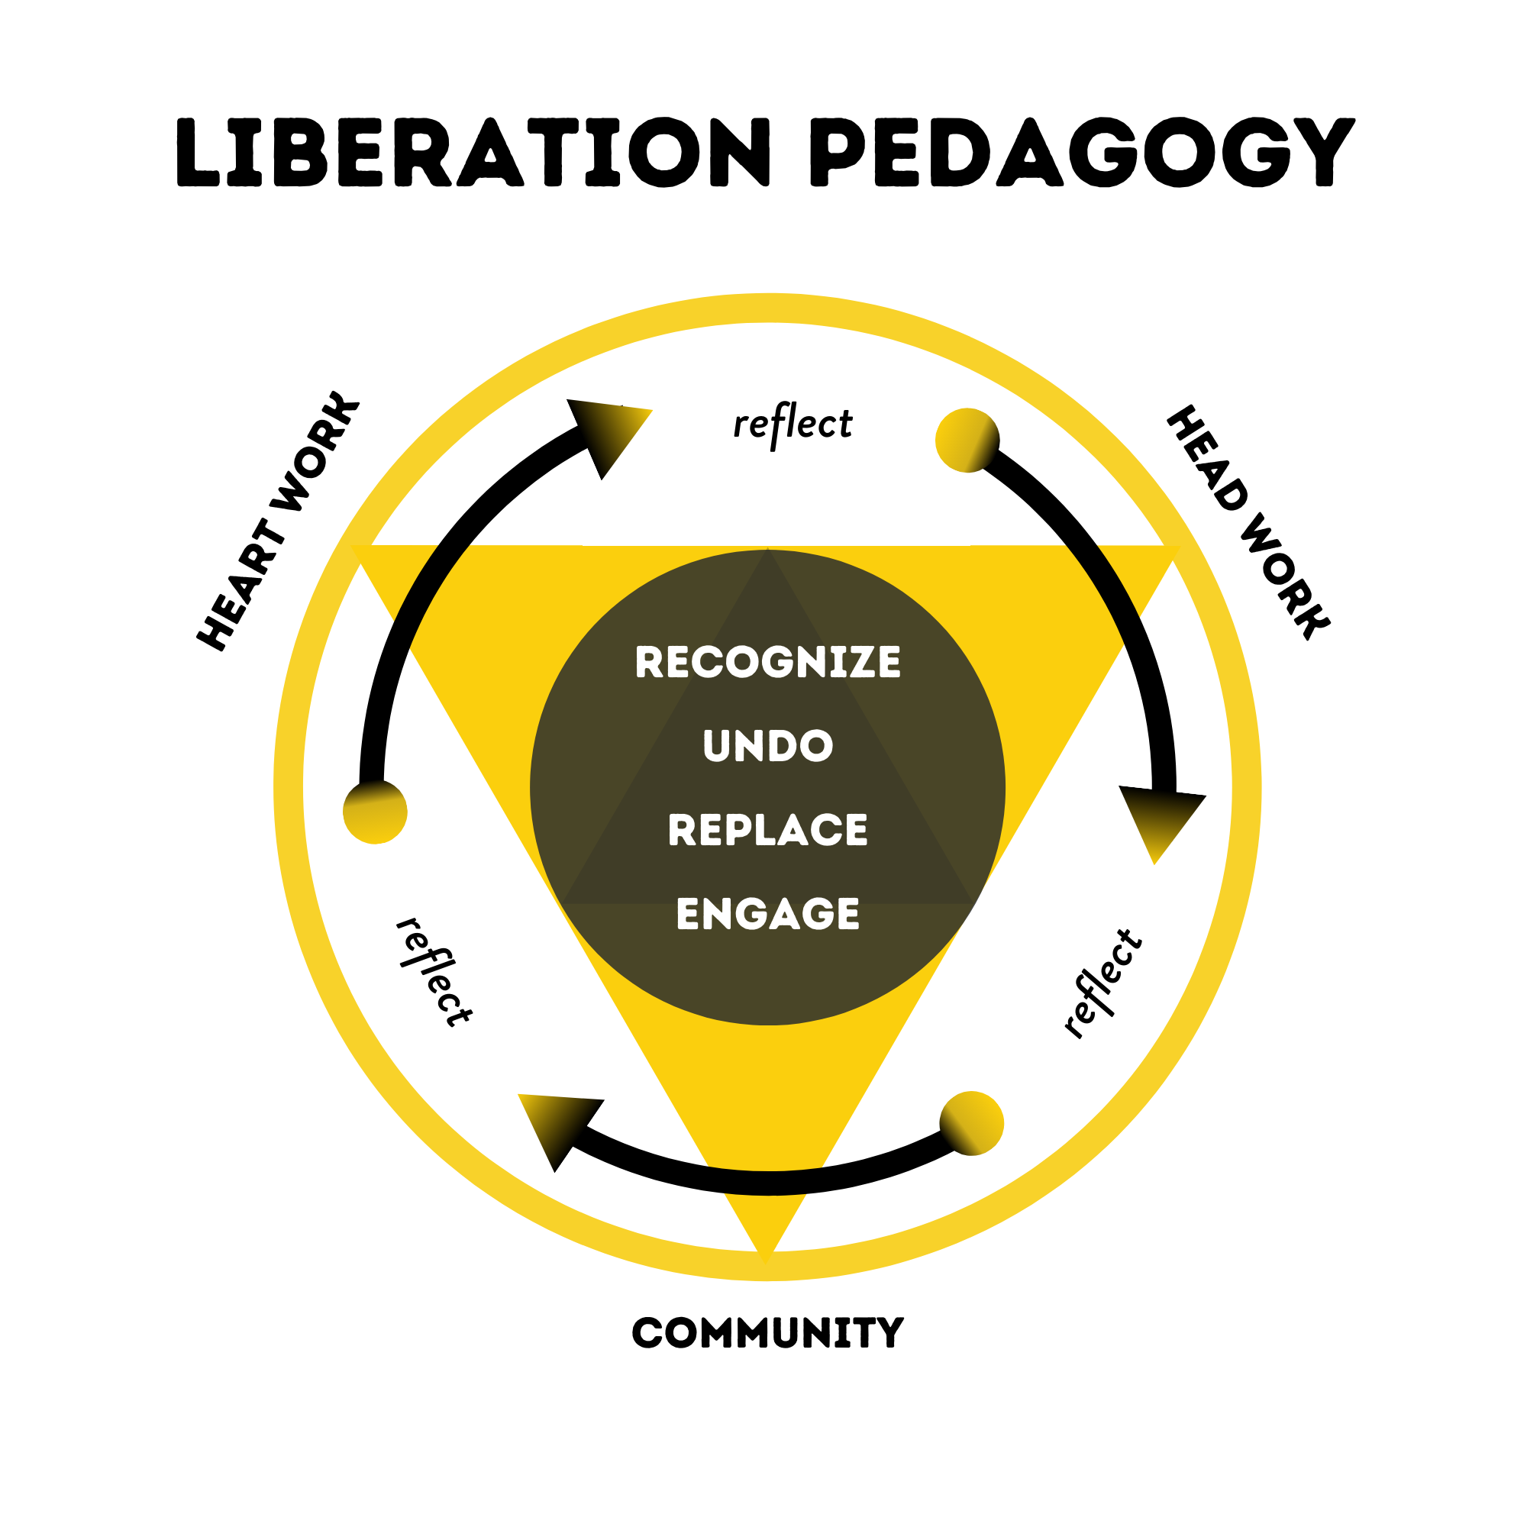
Early Career BIPOC
Advanced Career-BIPOC
Liberation Pedagogy
Advanced Career-white

Slide 4
Outcomes
In the weeds goals for today
Discuss what structural and interpersonal racism are
Real life student Narratives
Antiracist SEL and family engagement
Closing out
Big picture outcomes for today
continue to/don’t be racist!

Slide 5
Centering
How is your spirit today as we come into this space?
Notes:
Raedell:
what did you/your teachers do to check in with the class to check in with SEL

Slide 6
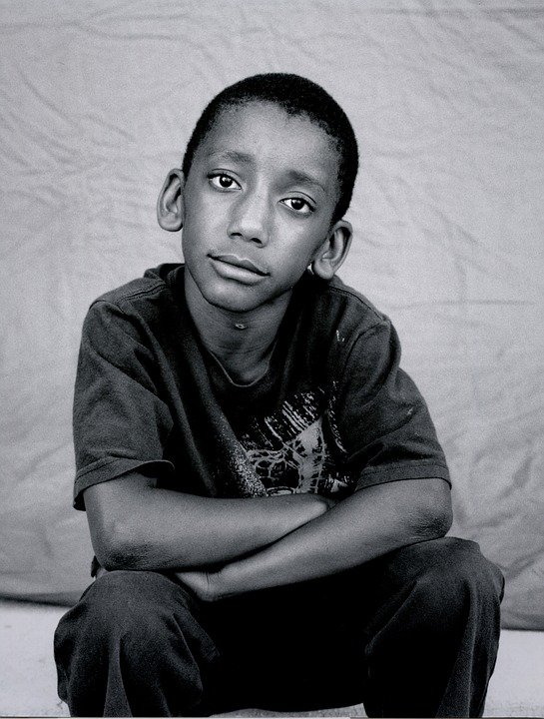
Sadly…
the many forms of racism
Institutional
racism
Individual
racism
Structural racism
Interpersonal racism
Are you aware of how these different forms of racism present themselves in your life?
How have these different types of racism impacted your life?
Do you observe these (types of racism) or do you experience them?
What does that mean for how you approach antiracism?
What is your why for being anti-racist?
Notes:
Raedell: Let’s get into talking about racism.
Process: on a scale of 1-10 how familiar are you with these types of racism-10 being i can call these out regularly in my life and practice and 1 being, i haven’t heard of them at all
The more we can get clear on what we mean when we say “racist” or “antiracist” the better we can challenge and disrupt it. Racism is still a word that is “taboo” for many white folx (including teachers) and that causes a burden for BIPOC folx to name and carry conversations about race. But if we can understand that we are talking about systems and centuries of deeply entrenched ideas, socializations, and so on, that are interpersonal, institutional, and structural as well as individual, it removes the burden from ME to me as one element in a huge system that we must all work to undo and eradicate. MIC DROP. (Kendi’s work really helpful in illuminating the complexities of racism).
Your Turn: Read the explanations: https://nmaahc.si.edu/learn/talking-about-race/topics/being-antiracist and (CLICK THE SLIDE) think about these Qs to process more what racism is.
Questions to consider:
Are you aware of how these different forms of racism present themselves in your life?
How have these different types of racism impacted your life?
Is it passive or overt? Do you observe these or do you experience them? What does that mean for how you approach antiracism?
What is your why for being anti-racist?

Slide 7
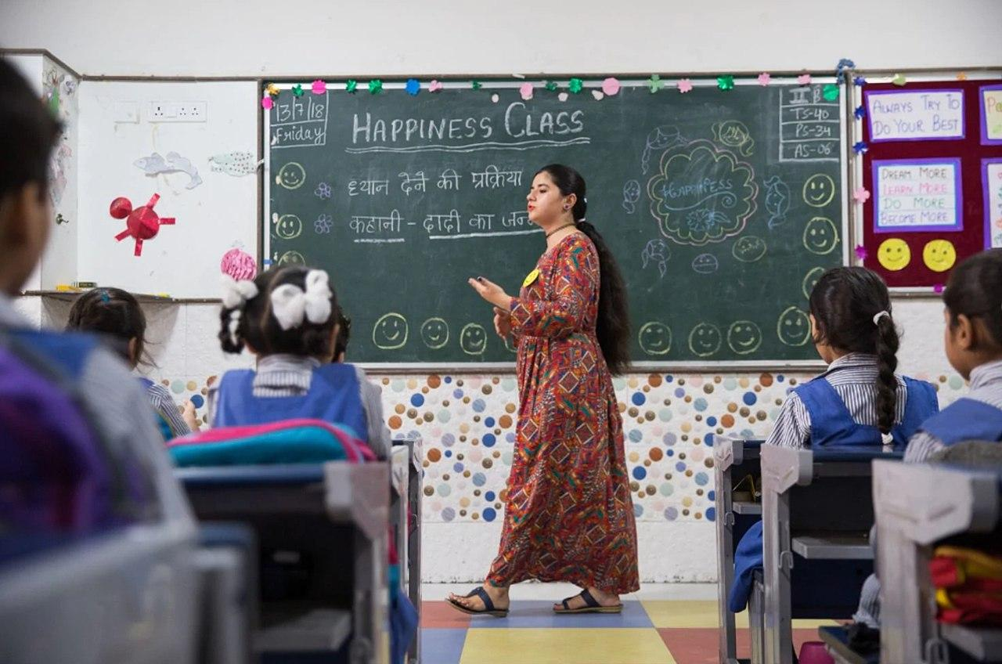
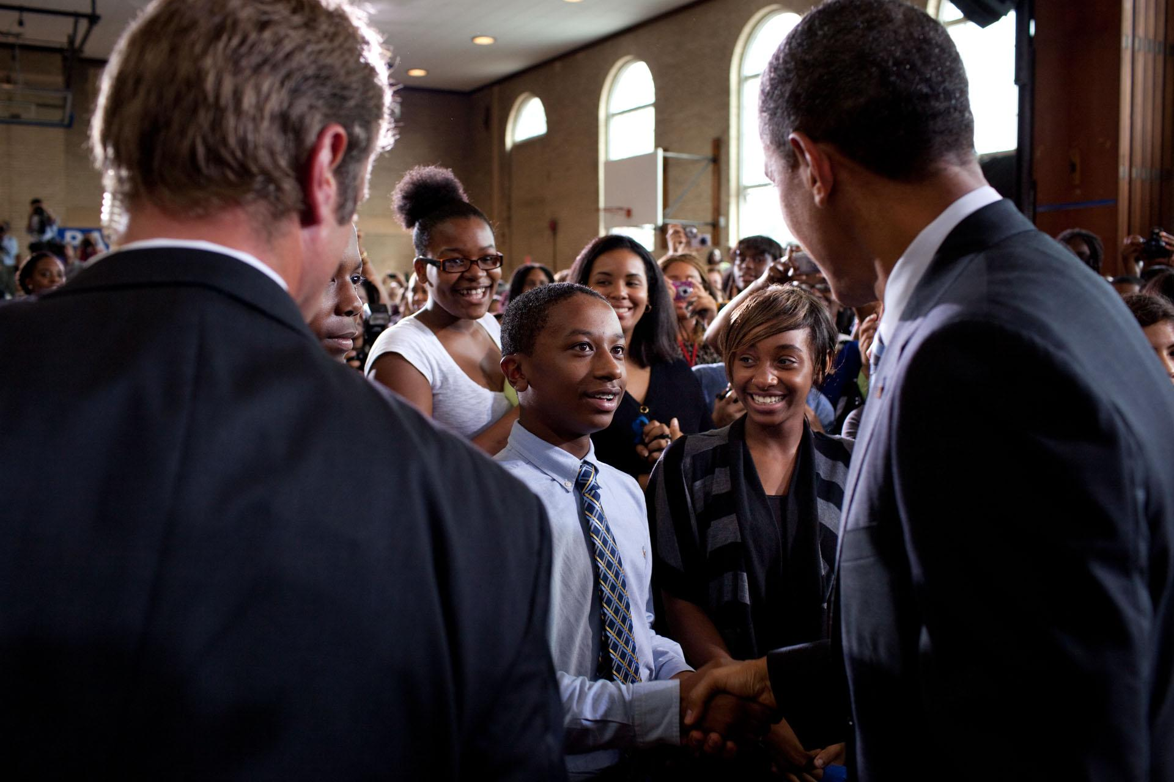
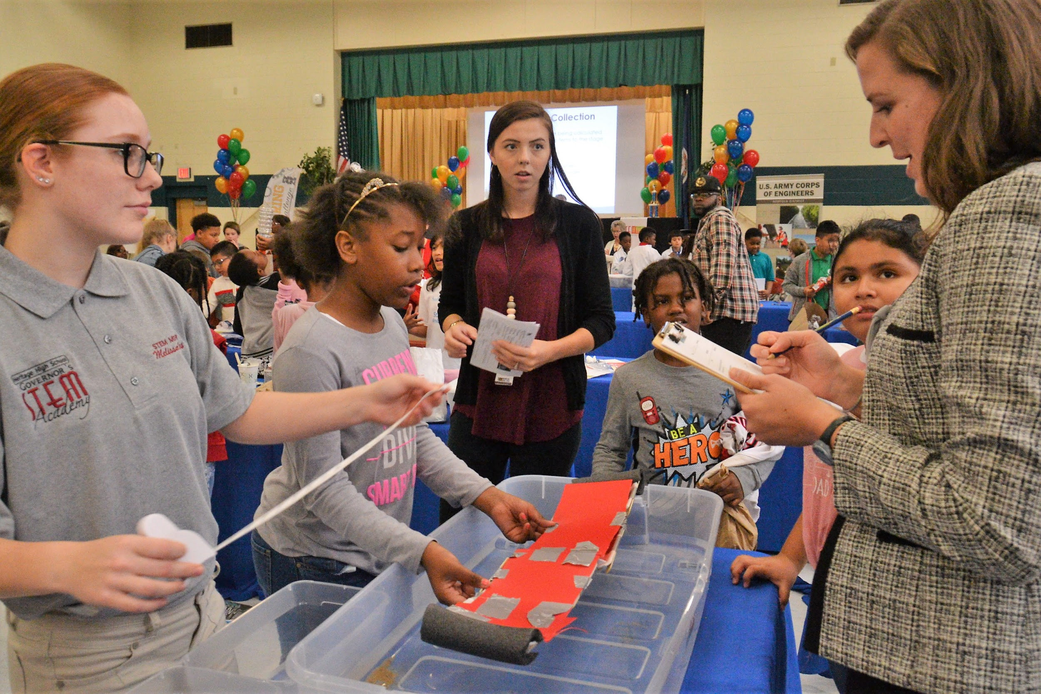
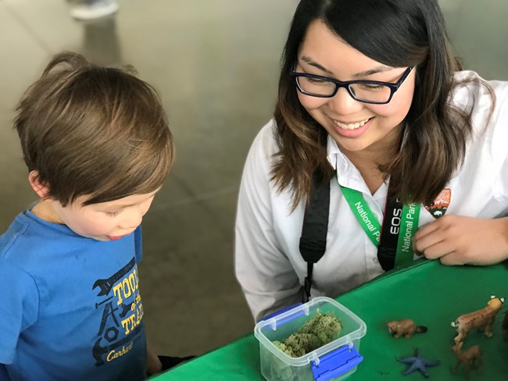
Real Life Narratives
Family
Student
Teacher
Notes:
(Jamboard!: https://jamboard.google.com/d/1FsPGaGO1yjUDvyJH-n_71A6p_I5JDILd0uC3p3h4LJ0/viewer?f=0
In what ways did the 4 types of racism show up?
Name some antiracist antidotes for better family engagement
Name some antiracist antidotes for better SEL

Slide 8
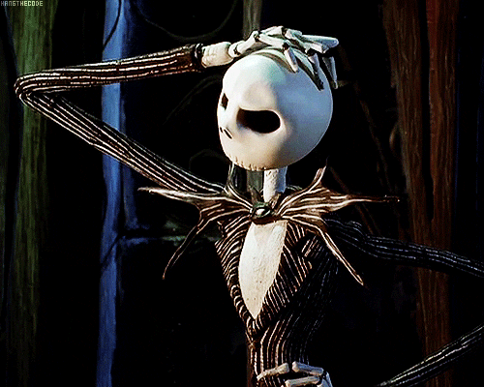
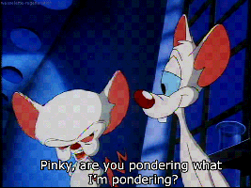
Now What?
Examining the SEL OSPI Standards
Examining your own practices around SEL
Revisit /Post up the types of racism
Continue to learn and understand what it means and looks like to be racist so you know what it means to be antiracist
1
2
3
4
5
6
Notes:
Raedell
Let’s be clear that observing from the outside it’s easier to empathize with the child/student and the parents even. But these teachers likely did not think they were doing anything wrong or racist for that matter. They likely thought they had the best of intentions. Deeply rooted Racism and surface level response to racism are what allow that. Think about what those teachers and their school leadership were socialized to believe or focus on in their practice as educators that led there.

Slide 9
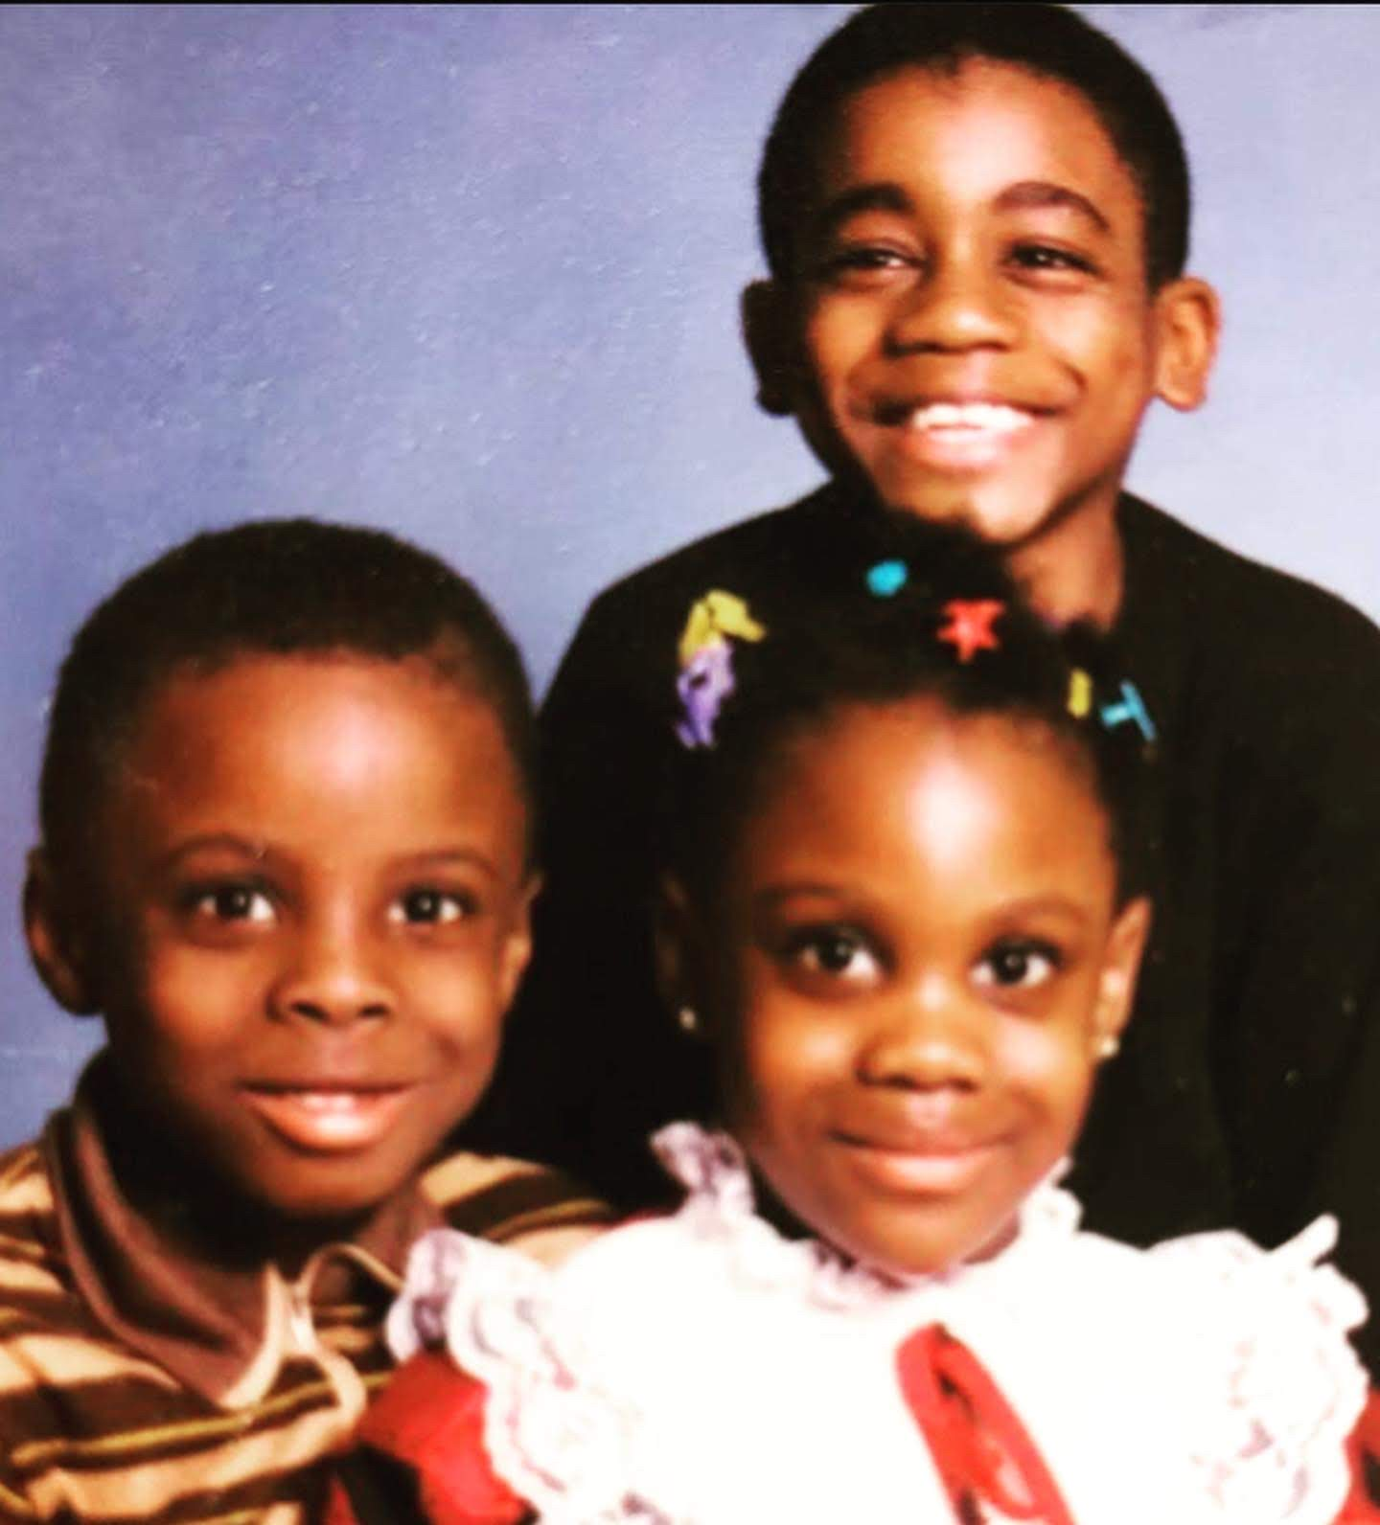
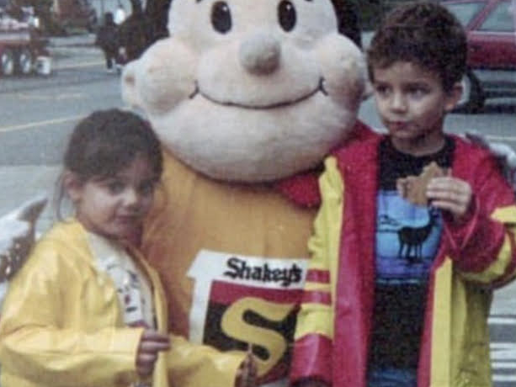
Our Roles as Antiracist Educators
Institutional
racism
Individual
racism
Structural racism
Interpersonal racism
Notes:
Saara: lots of things are at play and balancing all of what we can be mindful
inhabit role as educator and those oy impact. in understand what it means to be anti racist educators, in part, your job is to help shield your students from these systems of oppression, in classroom, sef, building, institutions, but also be a source of light, modeling what multicultural inclusive, and holistic support really looks like; understating that SEL resources, standards, etc., inherently center the cultural norms in which they were created, which are white dominant cultural norms, so our role as the umbrella and sun is essential.So for reference Dr. Raedell and I chose pictures of us and our brothers as youths because these are the types of faces and humans to keep in mind as your role as an antiracist educator.

Slide 10
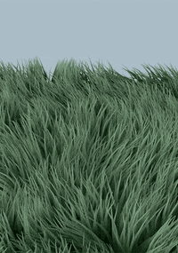
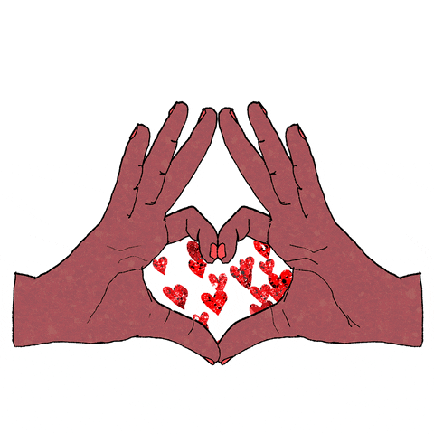
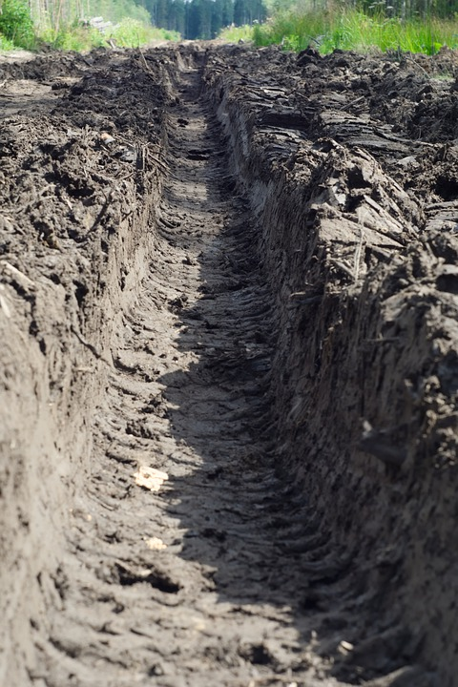
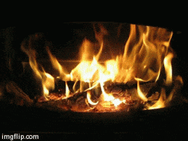
Closing out
No shame. No responsibility hoarding.
Let go. Learn. Keep Moving.
Release Jar
Notes:
Raedell
often for white folks shame and for BIPOC responsibility hoarding are the things that wears us out, hold us back, and blind us to the things to what we need to be doing so we’re going to engage in an activity to release those barriers
Jar to put examples from the past of racist things we have done. Drop in the chat. It can be something specific, like something you said or did that was not your best show of antiracism-like a time you witnessed a microaggression and said/did nothing/froze. OR it can be something broader that you haven’t committed to like you know/wish you had by now. For example, for me,I am releasing the need to try and fix every form and instance of oppression. It causes me anger, frustration, and really isn’t effective or sustainable. What are you releasing? Drop in the chat.
This image of mother earth is here because the earth is strong and powerful and the elements can withstand our stuff. Mother Earth can hold it. So think about how you want to let go...
Then, think about with Earthly element you want to help you let it go.., choose your element for how to release it (fire, water, bury it, let the waves wash it away, let the wind blow it away, love yourself into releasing the things that don’t serve your progress). Fire burns it up for me so that the physical representation of it is gone and I cant be continually reminded of it. But I do like knowing that embers become part of the air and never truly disappear. Even though I am burning the weight of it, the experience still helped shape who I am. So. what’s your element? Drop in the chat.
With that, thank you...

