Slide 1
Model Minority Stereotype and Racial Microaggressions: Implications for Effective Practice with Asian Americans
Paul Youngbin Kim, Ph.D.
Professor of Psychology Associate Dean for Diversity, Equity, and Inclusion

Slide 2
“I am Asian, so I know a lot of doctors.”
Andrew Yang, during the 3rd Democratic Party Presidential Debate on September 12, 2019

Slide 3
Learning Goals
What is the model minority stereotype?
What are racial microaggressions commonly experienced by AAs?
What can we/I do?
Case studies

Slide 4
Model Minority Stereotype Defined
“[belief that] Asian Americans are more successful than other racial minority groups based on their values emphasizing achievement and hard work and belief in unrestricted mobility toward progress” (Yoo, Burrola, & Steger, 2010, p. 117).

Slide 5
Model Minority Stereotype Defined
“[belief that] Asian Americans are more successful than other racial minority groups based on their values emphasizing achievement and hard work and belief in unrestricted mobility toward progress” (Yoo, Burrola, & Steger, 2010, p. 117).

Slide 6
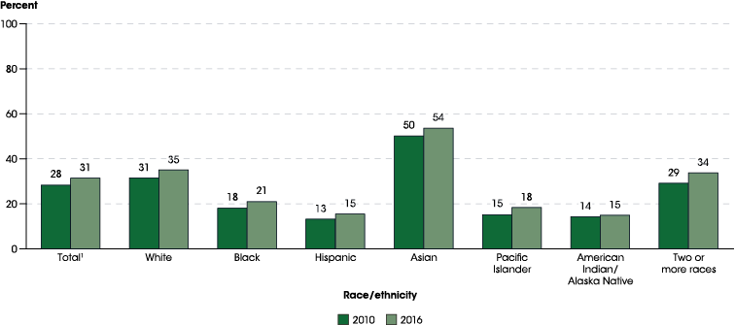
% of Adults (25 and up) with a bachelor’s or higher degree, by race/ethnicity
https://nces.ed.gov/programs/raceindicators/indicator_rfa.asp

Slide 7
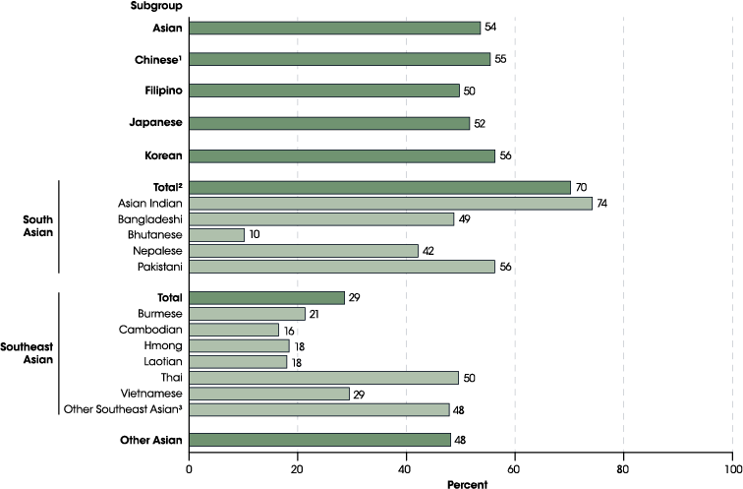
% of Adults (25 and up) with a bachelor’s or higher degree, by Asian subgroups: 2016
SOURCE: U.S. Department of Commerce, Census Bureau, American Community Survey (ACS), 2016. See Digest of Education Statistics 2017, table 104.40.

Slide 8
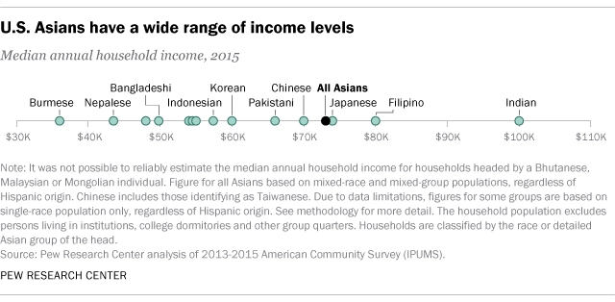
https://www.pewresearch.org/fact-tank/2017/09/08/key-facts-about-asian-americans/ft_17-09-08_asian_income/

Slide 9
Model Minority Stereotype Defined
“[belief that] Asian Americans are more successful than other racial minority groups based on their values emphasizing achievement and hard work and belief in unrestricted mobility toward progress” (Yoo, Burrola, & Steger, 2010, p. 117).
The MMS implies that AAs do not experience racial discrimination.

Slide 10
From STOP AAPI HATE
3795
2.3 X
12.6%
Number of incidents between March 19, 2020 and February 28, 2021
More women to report hate incidents compared to men
Of incidents are reported by youths (0-17)
https://stopaapihate.org/

Slide 11
Model Minority Stereotype Defined
“[belief that] Asian Americans are more successful than other racial minority groups based on their values emphasizing achievement and hard work and belief in unrestricted mobility toward progress” (Yoo, Burrola, & Steger, 2010, p. 117).
The MMS pits Asian Americans against other racial minority groups.

Slide 12
Outcomes
More unfavorable attitudes toward seeking professional psychological help (Kim & Lee, 2014)
More performance difficulty (Yoo et al., 2010)
More reporting of general and somatic distress symptoms (Yoo et al., 2010)

Slide 13
Learning Goals
What is the model minority stereotype?
What are racial microaggressions commonly experienced by AAs?
What can we/I do?
Case studies

Slide 14
What are racial microaggressions?
“Brief, everyday exchanges that send denigrating messages to people of color because they belong to a racial minority group” (Sue et al., 2007, p. 273).

Slide 15
What are racial microaggressions?
“Brief, everyday exchanges that send denigrating messages to people of color because they belong to a racial minority group” (Sue et al., 2007, p. 273).

Slide 16
What are racial microaggressions?
“Brief, everyday exchanges that send denigrating messages to people of color because they belong to a racial minority group” (Sue et al., 2007, p. 273).

Slide 17
Common RMs for Asian Americans
Alien in one’s own land
Homogenizing of Asian cultures
Perpetual foreigner stereotype
Pathologizing of cultural practices and values
Exoticization of women, desexualization of men
Sue et al., 2007

Slide 18
The cumulative experience of microaggressions can have significant impact on health.
Health and mental health correlates
Lower quality of sleep (Ong et al., 2017)
General health problems, pain, lower energy levels, and fatigue (Nadal et al., 2017)
Well-being (Kim et al., 2016)
Suicide ideation (Hollingsworth, 2017)

Slide 19
What can I/we do?
Reach out to AAPI students, colleagues, friends, and neighbors.
Present data that contradict the MMS (disaggregate!)
Tell (and listen to) stories of individuals who do not fit the MMS.
Monitor your own biases and assumptions about Asian Americans.

